Slide 1
AWS Module 5
Route 53 – DNS service
AWS Storage Gateway
Elastic Load Balancer (ELB)

Slide 2
What is Domain Name Server
DNS is a globally distributed service that translates human readable names like www.example.com into the numeric IP addresses like 192.0.2.1 that computers use to connect to each other.
The Internet’s DNS system works much like a phone book by managing the mapping between names and numbers. For DNS, the names are domain names (www.example.com) that are easy for people to remember and the numbers are IP addresses (192.0.2.1) that specify the location of computers on the Internet.
DNS servers translate requests for names into IP addresses, controlling which server an end user will reach when they type a domain name into their web browser. These requests are called "queries."

Slide 3
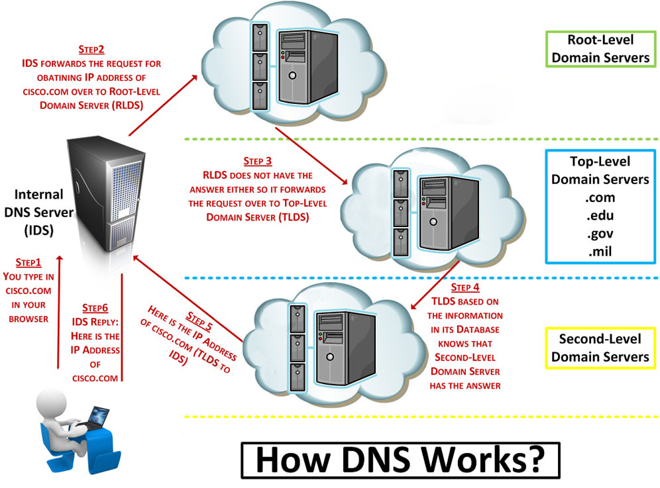
How DNS works

Slide 4
What is Amazon Route 53 ?
You can use Amazon Route 53 to help you get a website or web application up and running. Amazon Route 53 performs three main functions:
Register domain names – Your website needs a name, such as example.com. Amazon Route 53 lets you register a name for your website or web application, known as a domain name.
Route internet traffic to the resources for your domain – When a user opens a web browser and enters your domain name in the address bar, Amazon Route 53 helps the Domain Name System (DNS) connect the browser with your website or web application.
Check the health of your resources – Amazon Route 53 sends automated requests over the internet to a resource, such as a web server, to verify that it's reachable, available, and functional. You also can choose to receive notifications when a resource becomes unavailable and choose to route internet traffic away from unhealthy resources

Slide 5
What can I do with Route 53?
With Amazon Route 53, you can create and manage your public DNS records. Like a phone book, Route 53 lets you manage the IP addresses listed for your domain names in the Internet’s DNS phone book.
Route 53 also answers requests to translate specific domain names like into their corresponding IP addresses like 192.0.2.1. You can use Route 53 to create DNS records for a new domain or transfer DNS records for an existing domain.
The simple, standards-based REST API for Route 53 allows you to easily create, update and manage DNS records. Route 53 additionally offers health checks to monitor the health and performance of your application as well as your web servers and other resources. You can also register new domain names or transfer in existing domain names to be managed by Route 53.

Slide 6
What is Domain and Hosted Zone?
A domain is a general DNS concept. Domain names are easily recognizable names for numerically addressed Internet resources. For example, amazon.com is a domain.
A hosted zone is an Amazon Route 53 concept. A hosted zone is analogous to a traditional DNS zone file; it represents a collection of records that can be managed together, belonging to a single parent domain name.
All resource record sets within a hosted zone must have the hosted zone’s domain name as a suffix. For example, the amazon.com hosted zone may contain records named www.amazon.com, and www.aws.amazon.com, but not a record named www.amazon.ca. You can use the Route 53 Management Console or API to create, inspect, modify, and delete hosted zones. You can also use the Management Console or API to register new domain names and transfer in existing domain names into Route 53’s management.

Slide 7
The Name Server (NS) Resource Record Set
Amazon Route 53 automatically creates a name server (NS) resource record set that has the same name as your hosted zone. It lists the four name servers that are the authoritative name servers for your hosted zone. Do not add, change, or delete name servers in this resource record set.
The following examples show the format for the names of Amazon Route 53 name servers (just an example)
ns-2048.awsdns-64.com
ns-2049.awsdns-65.net
ns-2050.awsdns-66.org
ns-2051.awsdns-67.co.uk

Slide 8
The Start of Authority (SOA) Resource Record Set
The SOA record stores information about the name of the server that supplied the data for the zone; the administrator of the zone; the current version of the data file; the number of seconds a secondary name server should wait before checking for updates; the number of seconds a secondary name server should wait before retrying a failed zone transfer; the maximum number of seconds that a secondary name server can use data before it must either be refreshed or expire; and a default number of seconds for the time-to-live file on resource records.
Example
ns-2048.awsdns-64.net. hostmaster.example.com. 1 7200 900 1209600 86400

Slide 9
Route 53 – Routing Policy
Simple routing policy – Use for a single resource that performs a given function for your domain, for example, a web server that serves content for the example.com website.
Failover routing policy – Use when you want to configure active-passive failover.
Geolocation routing policy – Use when you want to route traffic based on the location of your users.
Latency routing policy – Use when you have resources in multiple locations and you want to route traffic to the resource that provides the best latency.
Weighted routing policy – Use to route traffic to multiple resources in proportions that you specify.

Slide 10
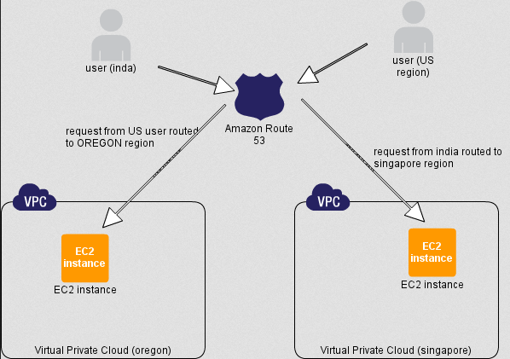
Route 53 - Geolocation

Slide 11
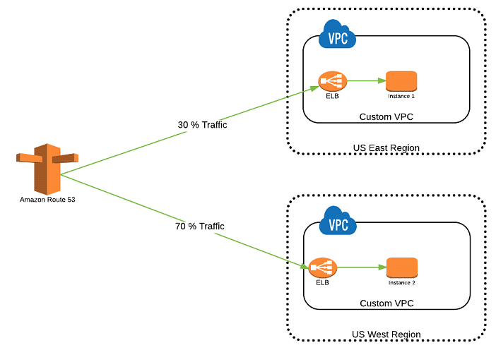
Route 53 - Weighted

Slide 12
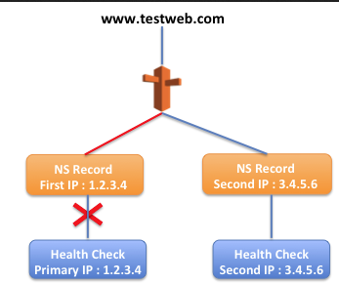
Route 53 – Failover

Slide 13
Differences between the A, CNAME, ALIAS and URL records
A, CNAME, ALIAS and URL records are all possible solutions to point a host name (name hereafter) to your site. However, they have some small differences that affect how the client will reach your site.
Before going further into the details, it’s important to know that A and CNAME records are standard DNS records, whilst ALIAS and URL records are custom DNS records provided by DNSimple’s DNS hosting. Both of them are translated internally into A records to ensure compatibility with the DNS protocol.
Here’s the main differences:
The A record maps a name to one or more IP addresses, when the IP are known and stable.
The CNAME record maps a name to another name. It should only be used when there are no other records on that name.
The ALIAS record maps a name to another name, but in turns it can coexist with other records on that name.
The URL record redirects the name to the target name using the HTTP 301 status code.
Some important rules to keep in mind:
The A, CNAME, ALIAS records causes a name to resolve to an IP. Vice-versa, the URLrecord redirects the name to a destination. The URL record is simple and effective way to apply a redirect for a name to another name, for example to redirect www.example.com to example.com.
The A name must resolve to an IP, the CNAME and ALIAS record must point to a name.
Which one to use
Understanding the difference between the A name and the CNAME records will help you to decide.
The general rule is:
use an A record if you manage what IP addresses are assigned to a particular machine or if the IP are fixed (this is the most common case)
use a CNAME record if you want to alias a name to another name, and you don’t need other records (such as MX records for emails) for the same name
use an ALIAS record if you are trying to alias the root domain (apex zone) or if you need other records for the same name
use the URL record if you want the name to redirect (change address) instead of resolving to a destination.

Slide 14
AWS Storage Gateway
AWS Storage Gateway connects an on-premises software appliance with cloud-based storage to provide seamless integration with data security features between your on-premises IT environment and the Amazon Web Services (AWS) storage infrastructure. You can use the service to store data in the AWS Cloud for scalable and cost-effective storage that helps maintain data security
AWS Storage Gateway offers file-based, volume-based and tape-based storage solutions
File Based :-File gateway is a type of AWS Storage Gateway that supports a file interface into Amazon S3 and that adds to the current block-based volume and VTL storage. File gateway combines a service and virtual software appliance, enabling you to store and retrieve objects in Amazon S3 using industry-standard file protocols such as Network File System (NFS).
File gateway provides a virtual file server, which enables you to store and retrieve Amazon S3 objects through standard file storage protocols.

Slide 15
AWS Storage Gateway
Volume Gateway – Volume gateway provides cloud-backed storage volumes that you can mount as Internet Small Computer System Interface (iSCSI) devices from your on-premises application servers. The gateway supports the following volume configurations:
Cached Volumes – You store your data in Amazon Simple Storage Service (Amazon S3) and retain a copy of frequently accessed data subsets locally. Cached volumes offer a substantial cost savings on primary storage and minimize the need to scale your storage on-premises. You also retain low-latency access to your frequently accessed data.
Stored Volumes – If you need low-latency access to your entire data set, you can configure your on-premises gateway to store all your data locally and then asynchronously back up point-in-time snapshots of this data to Amazon S3. This configuration provides durable and inexpensive off-site backups that you can recover to your local data center or Amazon EC2. For example, if you need replacement capacity for disaster recovery, you can recover the backups to Amazon EC2.

Slide 16
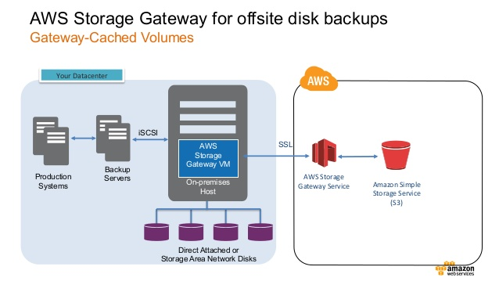
AWS Storage Gateway
In the cached mode, your primary data is written to S3, while retaining your frequently accessed data locally in a cache for low-latency access
In the stored mode, your primary data is stored locally and your entire dataset is available for low-latency access while asynchronously backed up to AWS.

Slide 17
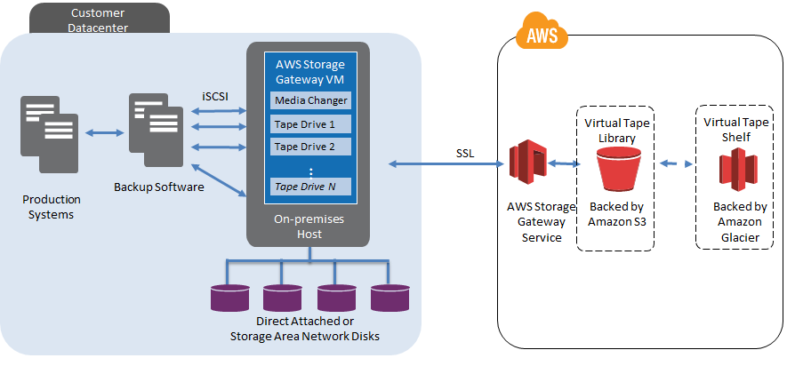
AWS Storage Gateway
Tape Gateway – You can cost-effectively and durably archive backup data in Amazon Glacier. Tape Gateway provides a virtual tape infrastructure that scales seamlessly with your business needs and eliminates the operational burden of provisioning, scaling, and maintaining a physical tape infrastructure.

Slide 18
AWS Storage Gateway
Key Point to remember
Each volume gateway can support up to 32 volumes.
In cached mode, each volume can be up to 32 TB for a maximum of 1 PB of data per gateway (32 volumes, each 32 TB in size).
In stored mode, each volume can be up to 16 TB for a maximum of 512 TB of data per gateway (32 volumes, each 16 TB in size).

Slide 19
Elastic Load Balancer
Elastic Load Balancing automatically distributes incoming application traffic across Amazon EC2 instances,containers, or resources identified by IP addresses.
It enables you to achieve fault tolerance in your applications, seamlessly providing the required amount of load balancing capacity needed to route application traffic.
Elastic Load Balancing offers two types of load balancers that both feature high availability, automatic scaling, and robust security. These include the Classic Load Balancer that routes traffic based on either application or network level information, and the Application Load Balancer that routes traffic based on advanced application level information that includes the content of the request.
The Classic Load Balancer is ideal for simple load balancing of traffic across multiple EC2 instances, while the Application Load Balancer is ideal for applications needing advanced routing capabilities, microservices, and container-based architectures.

Slide 20
How Elastic Load Balancer works?
A load balancer accepts incoming traffic from clients and routes requests to its registered EC2 instances in one or more Availability Zones.
The load balancer also monitors the health of its registered instances and ensures that it routes traffic only to healthy instances. When the load balancer detects an unhealthy instance, it stops routing traffic to that instance, and then resumes routing traffic to that instance when it detects that the instance is healthy again.
You configure your load balancer to accept incoming traffic by specifying one or more “listeners”.
A listener is a process that checks for connection requests. It is configured with a protocol and port number for connections from clients to the load balancer and a protocol and port number for connections from the load balancer to the instances.
With a Classic Load Balancer, you register instances with the load balancer. With an Application Load Balancer, you register the instances as targets in a target group, and route traffic to a target group

Slide 21
Availability Zones and Instances
When you enable an Availability Zone for your load balancer, Elastic Load Balancing creates a load balancer node in the Availability Zone. If you register instances in an Availability Zone but do not enable the Availability Zone, these registered instances do not receive traffic.
Cross-zone load balancing is always enabled for an Application Load Balancer and is disabled by default for a Classic Load Balancer.
Instance Protocol
HTTP
HTTPS
TCP
SSL

Slide 22
ELB Connection Draining
When you enable Connection Draining on a load balancer, any back-end instances that you deregister will complete requests that are in progress before deregistration. Likewise, if a back-end instance fails health checks, the load balancer will not send any new requests to the unhealthy instance but will allow existing requests to complete.
This means that you can perform maintenance such as deploying software upgrades or replacing back-end instances without impacting your customers’ experience.
Connection Draining is also integrated with Auto Scaling, making it even easier to manage the capacity behind your load balancer. When Connection Draining is enabled, Auto Scaling will wait for outstanding requests to complete before terminating instances.

Slide 23
ELB Sticky Session
You can use the sticky session feature (also known as session affinity), which enables the load balancer to bind a user's session to a specific instance.
This ensures that all requests from the user during the session are sent to the same instance.
The key to managing sticky sessions is to determine how long your load balancer should consistently route the user's request to the same instance. If your application has its own session cookie, then you can configure Elastic Load Balancing so that the session cookie follows the duration specified by the application's session cookie. If your application does not have its own session cookie, then you can configure Elastic Load Balancing to create a session cookie by specifying your own stickiness duration.

Slide 24
LAB
Route 53 LAB
Elastic Load Balancer LAB

